Slide 1

Review of Ch 9 Long-lived assets
Depreciation of PPE
Derecognition of PPE
Update depreciation
Depreciation for the fraction of the year to the date of disposal must be recorded
Calculate carrying amount = Cost – Accumulated depreciation
Calculate gain or loss=Proceeds – carrying amount
Record disposal: Remove cost of asset and accumulated depreciation. Record proceeds and gain or loss on disposition
Straight-line | (Cost−Residual Value)/ Useful life
Diminishing-balance | (Cost−Accumulated Depreciation)×Depreciation Rate (Straight-Line Rate×Multiplier)
Units-of-production | (Cost−Residual Value)/(Total Estimated Units of Activity)×(Actual Units of Activity During the Year)

Slide 2
Review of Ch 9 Long-lived assets
In class exercise (P9-3A)
Questions:
What is the cost of the machine?
(b) Based on the double-diminished balance method, what is the accumulated depreciation by the end of 2019?
(C) Discuss the impact of the cost to recycle the machine at the end of its life to the depreciation schedule.

Slide 5
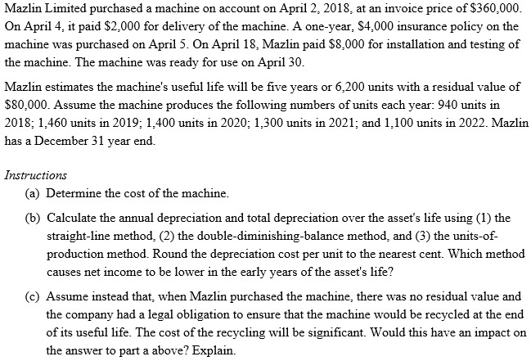
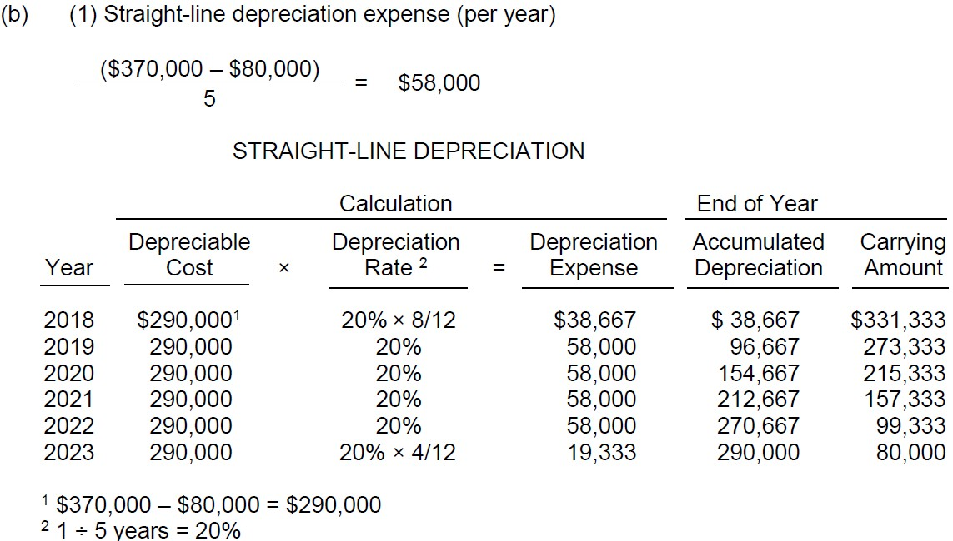
Exercise P9-3A: Depreciation 1

Slide 6
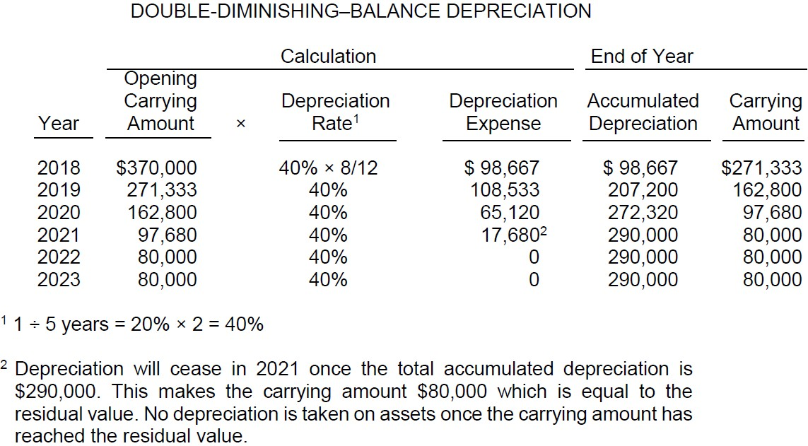
P9-3A: Depreciation 2

Slide 7
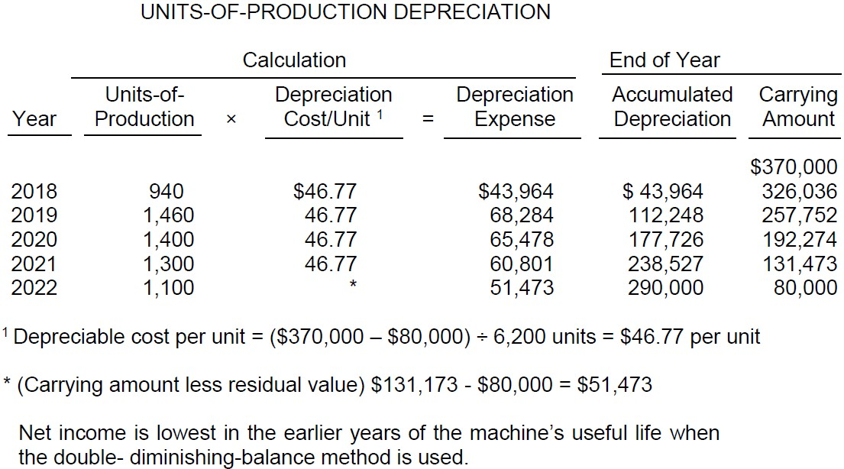
Exercise P9-3A: Depreciation 3

Slide 8
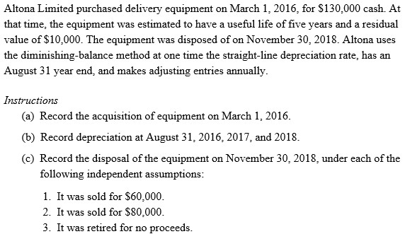
In-Class Exercise (P9-6A)
Poling Question: What is the disposal gain/loss if the machine was sold for $60,000?

Slide 12
Ch10 A FURTHER LOOK AT FINANCIAL STATEMENTS
LO 1: Account for current liabilities.
LO 2: Account for instalment notes payable.
LO 3: Identify the requirements for the financial
statement presentation and analysis of liabilities.

Slide 13
Current Liabilities
Types of current liabilities include:
Bank indebtedness from operating lines of credit
Accounts payable and accrued liabilities
Unearned revenue
Notes and loans payable
Sales taxes Federal: GST; Provincial: PST or QST; Combined as harmonized sales tax (HST) in some provinces
When paid, debit Sales Tax Payable account, credit Cash
Property taxes
Payroll
Current maturities of non-current debt
Provisions and contingent liabilities
Expected to be paid or settled:
Through payment by cash, through the transfer of goods or services or through the creation of other current liabilities

Slide 14
Operating Line of Credit
Pre-arranged agreement between a company and a lender to allow the company to borrow up to an agreed-upon amount
A quick cash from bank to help manage temporary cash shortfalls
Interest is charged using a floating (or variable) interest rate
Security (collateral – normally company’s CA) may be required by bank
Use ‘bank indebtedness’ account in BS

Slide 15
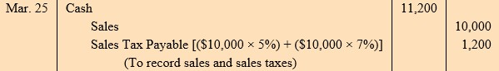
Sales Tax Payable
Federal Goods and Services Tax (GST): 5%
Provincial Sales Tax (PST or QST): 0 ~ 10%
Combined into one harmonized sales tax (HST) in some provinces – ex. Ontario: 13 ~ 15%
Since company (seller) is acting as a collection agent, sales tax must be remitted periodically to respective governments
When remitted) Sales Tax Payable 1,200 / Cash 1,200

Slide 16
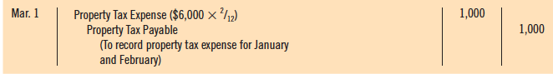
Property Taxes
Businesses that own property pay property taxes for each calendar year to municipal or provincial governments
Property taxes are calculated at a specified rate for every $100 of the assessed value of the property
Upon receipt of the property tax bill (assume in March), an expense is recorded for the months that have passed
Eg. The whole year tax bill: 6000. Adjusting entry on Mar 1

Slide 17
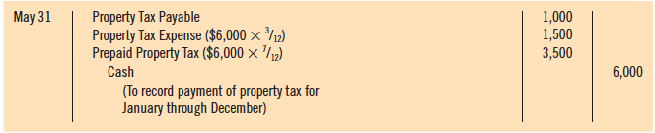
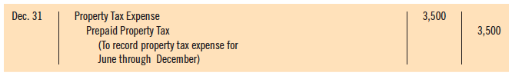
Property Taxes Payable (Continued)
When paid (assume in May), expense is recorded for additional months that have passed, and prepaid is set up for remaining months
Eg. Paid 6000 on May 31. The whole year tax bill: 6000
Prepaid is cleared to expense at the end of year

Slide 18
3 Types of Liabilities related to salaries / wages
Salary or wages owed to employees (known as gross pay)
Employer payroll obligations
Employer’s share of Canada pension plan (CPP) and EI
Workers’ compensation
Employee benefits:
Compensated absences (vacation, statutory holidays)
Employer-sponsored health plans and pensions
Payroll deductions from employees’ gross pay
Mandatory
Voluntary

Slide 19
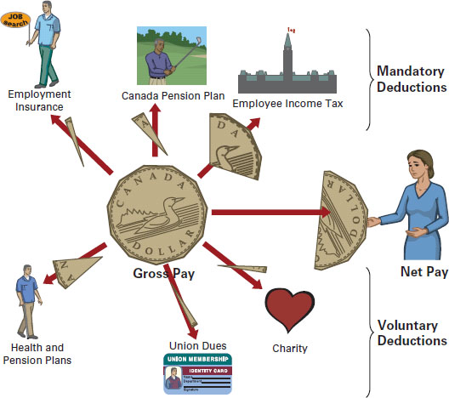

Slide 20
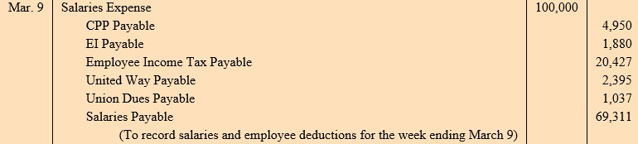
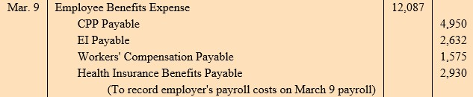
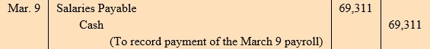
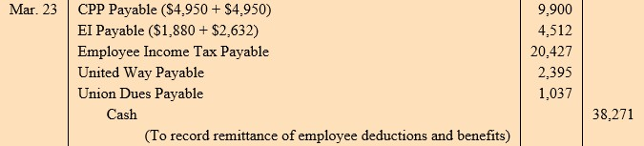
Payroll
← Gross pay & deductions
Could be Cash for Salary / P, then omit Mar 9
← Employer obligations
← Net pay
← Remittance

Slide 21
(Short-Term) Notes Payable
A promise to pay a specified amount either at a future date or on demand (similar to AR vs. NR)
Often used instead of accounts payable
Provide written documentation, if needed, for legal remedies
Normally has interest attached (at a fixed annual rate)
Issued for varying periods of time:
If due within one year of financial statement date, they are classified as current liabilities

Slide 22
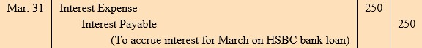
(Short-Term) Notes Payable
Assume that HSBC Bank (the payee) lends $100,000 to Williams Ltd. (the payer) on March 1. Because this note constitutes a loan from a bank, it is commonly referred to as a bank loan payable. The terms notes and loans are often used interchangeably. The loan is due in four months, on July 1, and bears interest at 3%. Both the principal amount ($100,000) of the loan and the related interest are payable at maturity.
Loan issuance
Adjusting entry at the fiscal year end of March 31

Slide 23
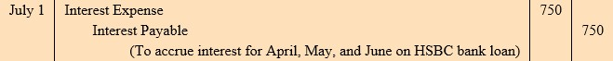
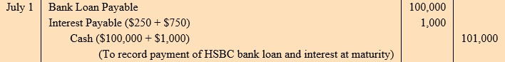
(Short-Term) Notes Payable
Assume that HSBC Bank (the payee) lends $100,000 to Williams Ltd. (the payer) on March 1. Because this note constitutes a loan from a bank, it is commonly referred to as a bank loan payable. The terms notes and loans are often used interchangeably. The loan is due in four months, on July 1, and bears interest at 3%. Both the principal amount ($100,000) of the loan and the related interest are payable at maturity.
Repayment of loan and interests

Slide 24
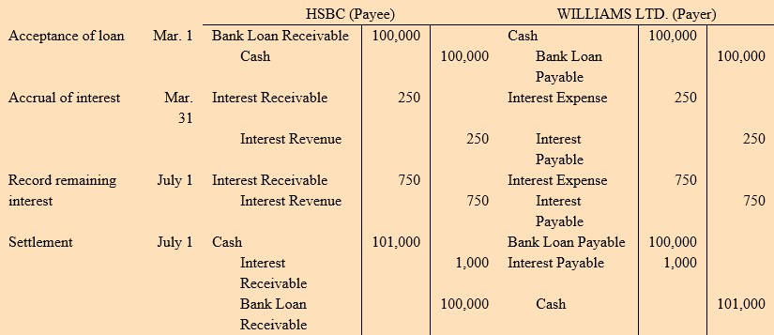
(Short-Term) Notes Payable
Assume that HSBC Bank (the payee) lends $100,000 to Williams Ltd. (the payer) on March 1. Because this note constitutes a loan from a bank, it is commonly referred to as a bank loan payable. The terms notes and loans are often used interchangeably. The loan is due in four months, on July 1, and bears interest at 3%. Both the principal amount ($100,000) of the loan and the related interest are payable at maturity.

Slide 25
Uncertain Liabilities
Events with certain outcomes:
To whom an obligation is owed
When the obligation may have to be settled
What amount is needed to settle obligation
Provisions are uncertain as to timing or amount
- Recorded because:
Their outcome is probable
Amount owed can be estimated (ex. warranties, gift cards, etc)
- Probable defined as “more likely than not” (IFRS) – over 50%
Contingent liabilities are possible obligations that are dependent upon some future event
- Uncertainty of the outcome is not considered probable or determinable; or
outcome cannot be estimated (ex. outcome of few lawsuits)
- Not recorded, only notes to financial statements

Slide 26
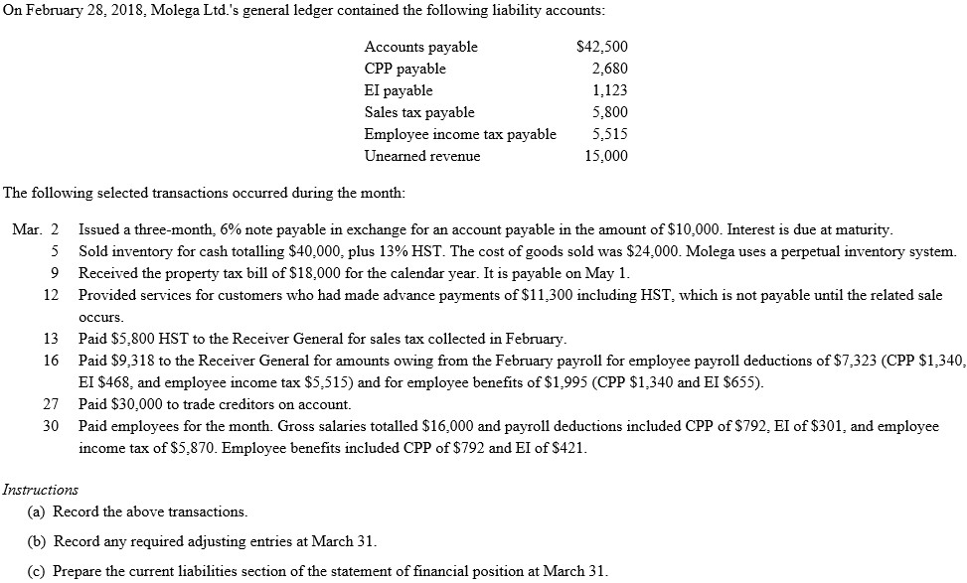
In-Class Exercise (P10-1A)

Slide 27
(a)

Slide 30
Non-Current Liabilities
Obligations to be paid after one year or more
Includes instalment notes payable, bonds payable, deferred income taxes, pension liabilities, and finance leases (→ more in Intermediate Acct.)
May be secured or unsecured- secured notes are known as mortgages if the note has property as collateral

Slide 31
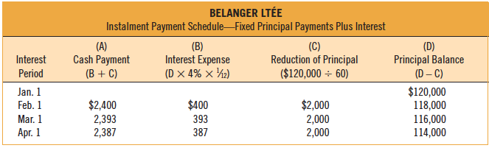
Installment Payment Schedule — Fixed Principal Payments
Installments: repayable in a series of periodic payments
Loan is repayable in equal periodic amounts plus interest
Example:
Assume that Belanger Ltée borrows $120k for 5 years at 4%
monthly installment payments of $2,000 ($120,000 ÷ 60)
Monthly interest expense is calculated by multiplying the outstanding principal balance by the interest rate

Slide 32
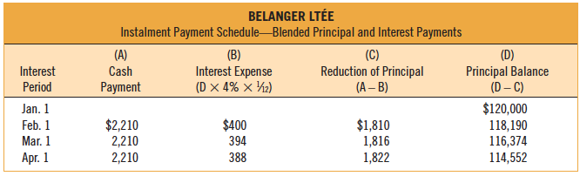
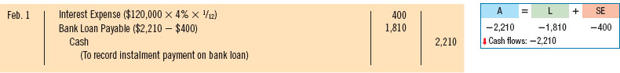
Installment Payment Schedule — Blended Payments
Loan is repayable in equal periodic amounts including interest
Example: Belanger Ltée repays its $120,000, 4%, 5-year loan payable in equal monthly installments of $2,210
Monthly interest expense is still calculated by multiplying the outstanding principal balance by the interest rate

Slide 33
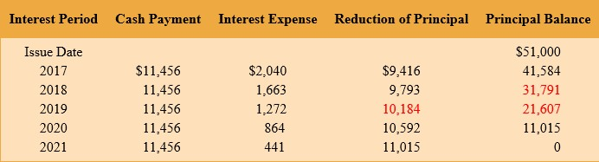
Current Maturities of Non-Current Debt
The portion of non-current (long-term) debt that is due within the current year or operating cycle should be classified as a current liability
Ex) As of end of 2018, total liability ($31,791) can be decomposed into current portion ($10,184) that will be paid in 2019, and long-term portion ($21,607) that will be paid in 2020 and 2021.

Slide 34
Statement Presentation
Current liabilities
Reported as the first category of liabilities
Can be listed separately on statement of financial position or detailed in the notes
Normally listed in order in which they are due
Non-current liabilities
Report separately in B/S and detail in notes
Measured and reported at amount due when liability is expected to be paid

Slide 35
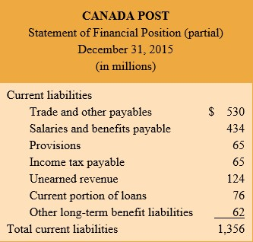
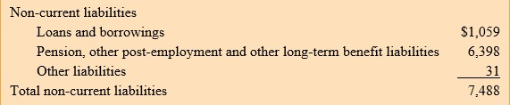
More detailed information is stated in the notes
LT liabilities needs to be shifted to CL when due within a year

Slide 36
Analysis of Debt Obligations
Liquidity –short-term ability to pay maturing obligations and meet unexpected cash needs within a year
Current ratio: CR = CA / CL
Inventory turnover ratio
Working Capital = CA - CL
Receivables turnover ratio
Solvency –ability to meet long-term obligations
Debt to Total Assets =
Total Liabilities
Times Interest Earned = | (Net Income + Interest Expense+ Income Tax Expense) or EBIT
 | Interest Expense
Total Assets

Slide 37
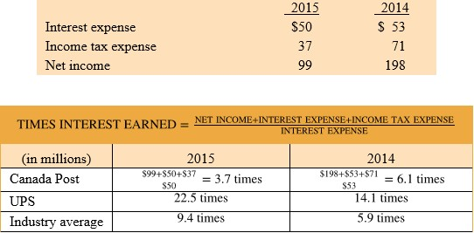
Times Interest Earned
Always consider both DA (DE) ratio and Times Interest Earned together when analyzing the solvency of a firm

Slide 38
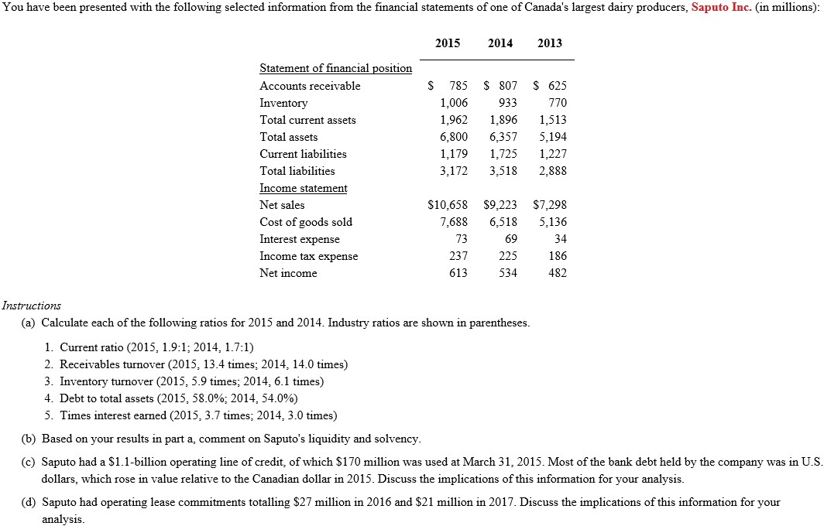
In-Class Exercise (P10-7A)

Slide 39
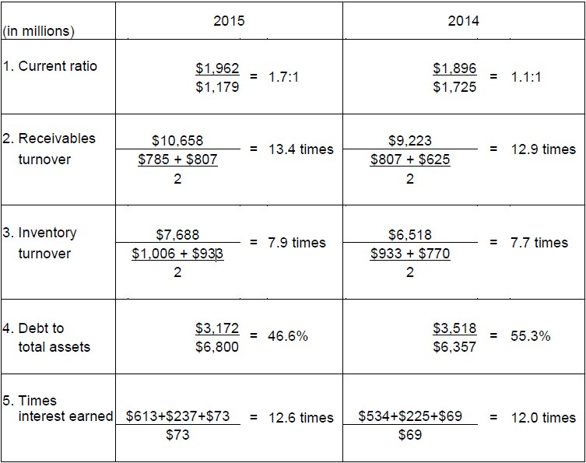
In-Class Exercise (P10-7A)
(a)

Slide 40
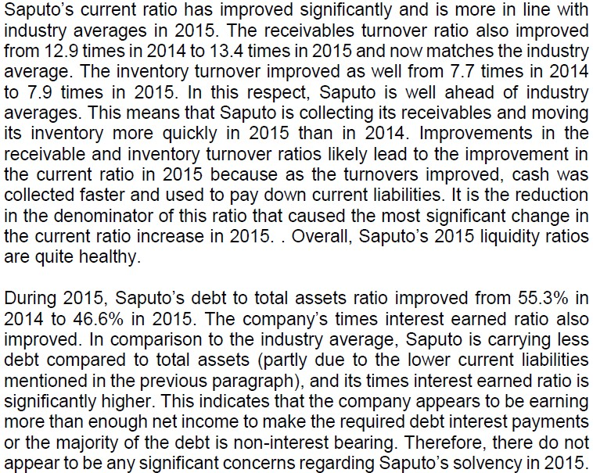
In-Class Exercise (P10-7A)
(b)

Slide 41
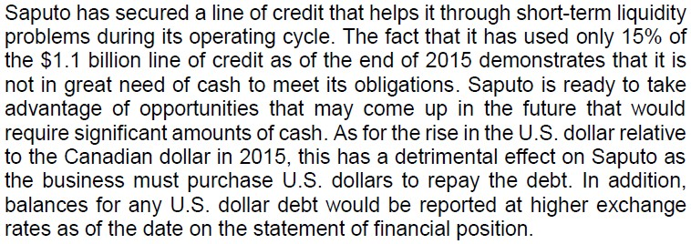
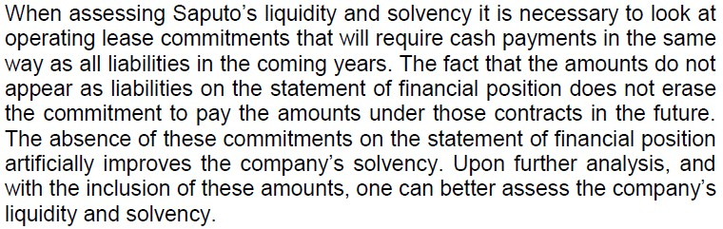
In-Class Exercise (P10-7A)
(c)
(d)

Slide 42
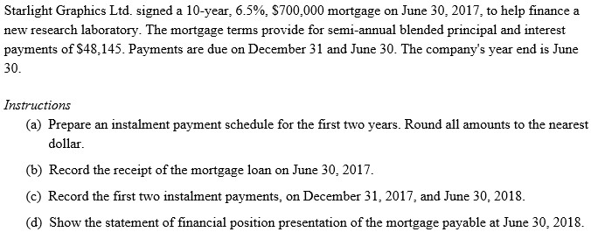
In-Class Exercise (P10-4A)

